Slide 1

Week 4 – Lecture Notes
What It happened - Diagnostic Analytics

Slide 2
Introduction
Linear? Or curve?

Slide 3

Introduction
Figure 4.1 shows an image depicting characteristics of a cell nuclei.
In order to help treat a cancer patient, scientists need to determine whether the cell nuclei is benign or malignant (cancerous).
How efficiently can a judgement be made? Regression analysis can help.
Figure 4.1. One of the cell images from the Wisconsin Breast Cancer dataset

Slide 4
Introduction
Decisions are often made based on the relationship between two or more variables.
For example, generally speaking, more advertising expenditures would bring more sales. Based on this relationship, a marketing manager can decide how much to spend on advertisements.
Sometimes a manager needs to rely on his intuition to judge how two variables are related.
However, if data can be obtained, an analytics technique called regression analysis can be used to develop a model showing this relationship.

Slide 5
Simple Linear Regression
It is both Simple and Difficult

Slide 6
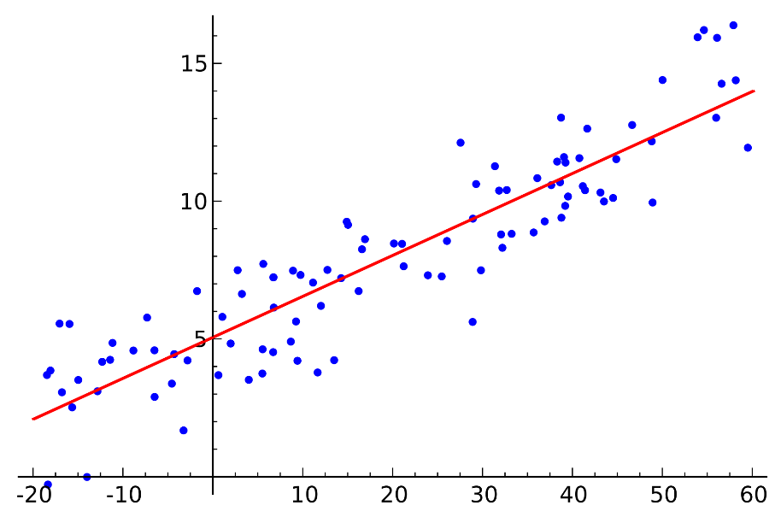
Simple Linear Regression
Understanding of Regression:
When plotting a set of data, the data often follows a trend (or pattern). Regression is to draw a line (lineal or non-lineal) to represent this trend, or in other words, to model the relationship between the dependent variable and the independent variables.
Each node is one piece of data
The red line can roughly represent the trend of the data
The red line also roughly models the relationship between the dependent and independent variables

Slide 7
Simple Linear Regression
Dependent variable: A variable value is being predicted
Independent variables: Variables being used to predict the dependent variable
Take this node for example, in this dataset, it represents:
{x=29, y=8}
If we consider it in the marketing case as on page 4, it means when spending $29k on advertising, the company can earn $8m sales.
So in this case, x is the independent variable while y is the dependent variable. The value of y is dependent on x (how x changes).
y
x

Slide 8
Simple Linear Regression
Linear relationship: Any change in the independent variable, is assumed to result in the relevant change in the dependent variable.
Two types of regression:
Simple regression: A simple regression analysis involving one independent variable and one dependent variable.
Multiple regressions: Regression analysis involving two or more independent variables.

Slide 9
Simple Linear Regression
Some examples:
One of the most important factors in selecting a bicycle for racing is its weight, so weight could be an independent variable for the price.
In a manufacturing process, the assembly line speed (feet per minute) was thought to affect the number of defective parts.
Weight
Price
x
y
Line Speed
No. of Defective parts
x
y

Slide 10
Simple Linear Regression
Example:
For vehicle wheel alignment: maintenance expense is related to usage:
Weekly Usage
Annual Maintenance Expense
x
y

Slide 11
Regression Model
What does the model look like?

Slide 12
Simple Linear Regression Model
Regression Model: The equation that describes how y is related to x and an error term.
Simple Linear Regression Model
y = ax + b
‘x’ is the independent variable and ‘y’ is the dependent variable.
‘a’ and ‘b’ are two parameters.
‘a’ displays the slope of the regression line
‘b’ is the intercept of the regression line
When x changes, y also changes accordingly.
Once the parameters are set, they won’t change and becomes constant.

Slide 13
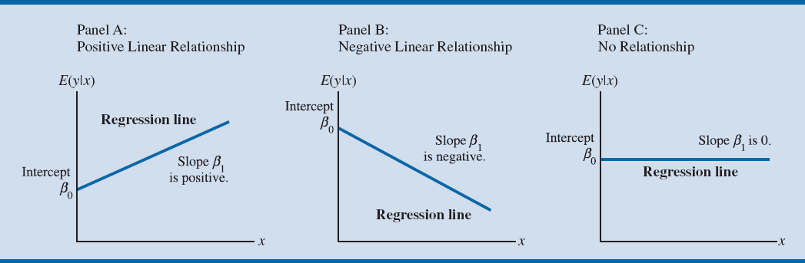
Simple Linear Regression Model
Intercept ‘b’
Slope ‘a’ is negative.
Intercept ‘b’
Slope ‘a’ is 0.
Intercept ‘b’
Slope ‘a’ is positive
Figure 4.2. Possible Regression Lines in Simple Linear Regression
Positive relationship
Negative relationship
No relationship
Notes:
The regression line in Panel A shows that the mean value of y is related positively to x, with larger values of E(y|x) associated with larger values of x.
In Panel B, the mean value of y is related negatively to x, with smaller values of E(y|x) associated with larger values of x.
In Panel C, the mean value of y is not related to x, that is, E(y|x) is the same for every value of x.

Slide 14
Multiple Regression Model
When the regression analysis involves two or more independent variables.
Multiple Regression Model
y = ax₁ + bx₂ + cx₃ + dx₄ . . .
‘x₁, x₂, x_{3…}’ are the independent variables and ‘y’ is the dependent variable.
‘a, b, c, d…’ are parameters.
In this formula, we can see y can be affected by all the ‘x1, x2, x3…’.

Slide 15
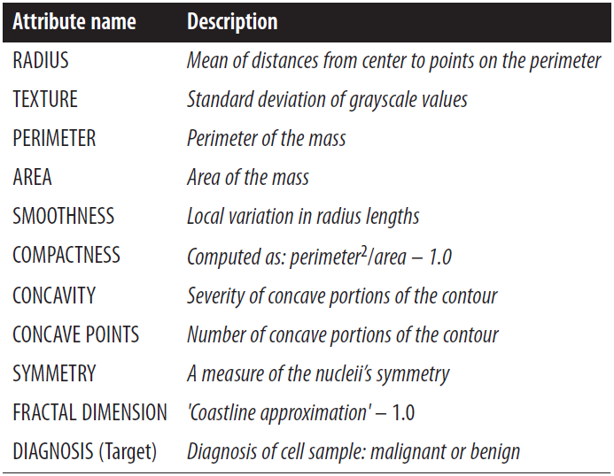
Multiple Regression Model
Back to the opening example on page 3, scientists need to look at several variables to determine whether a cell nuclei is benign or malignant (cancerous).
In this case, all these attributes could determine a healthy cell nuclei, therefore, a multiple regression model is needed.

Slide 16
Conclusion and Notes
This chapter helps you understand the relationship between two variables using the regression technique.
You are not required to use MS Excel in this course.
We will show you how to apply regression modelling in RapidMiner in the collaborative session this Thursday.

Slide 17
Additional Reading

Slide 18
Least Squares Method
Least squares method: A procedure for using sample data to find the estimated regression equation.
Here, we will determine the values of a and b.
Interpretation of b and a:
The slope a is the estimated change in the mean of the dependent variable y that is associated with a one unit increase in the independent variable x.
The y-intercept b is the estimated value of the dependent variable y when the independent variable x is equal to 0.

Slide 19
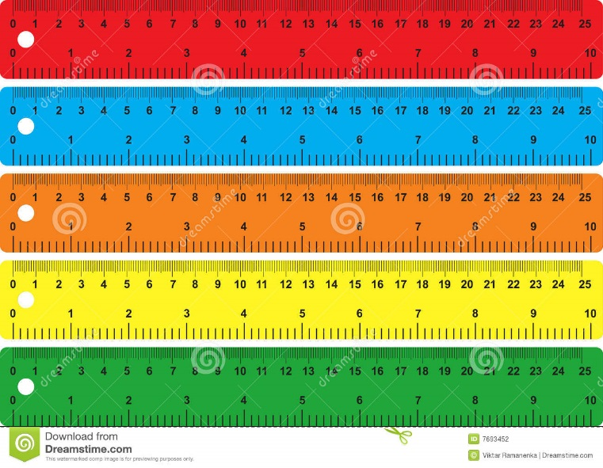
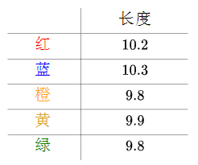
Least Squares Method
Example:
Five rulers are used to measure the length of a line. The results are:
Red
Length
Blue
Red
Orange
Blue
Orange
Yellow
Yellow
Green
Green
Errors raised may be due to various reasons such as the resolution and distortion of the rulers etc.

Slide 20
Least Squares Method
The easiest way to obtain the length of the line is to calculate the mean of the five values:
$$\overline{y}=\frac{10.2+10.3+9.8+9.9+9.8}{5}=10$$
However, does this make sense? Why not use harmonic mean? Why not use median? Why not use geometric mean?
Simply using a mean value for the true length raises lots of questions and queries.

Slide 21
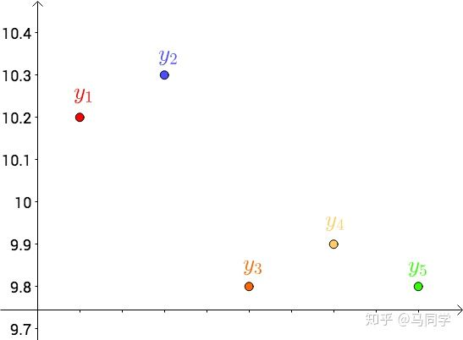
Least Squares Method
Least square solution:
Let us put the five values in a matrix, as shown in the following figures.
Measurements returned by using the five rulers
Five rulers are represented as x1 - x5.
x1
x2
x3
x4
x5

Slide 22
Least Squares Method
Least square solution:
Draw an imaginary line to represent the true length (y*), say y*=10.05
Imagine y*=10.05 is the true length of the line
y*
x1
x2
x3
x4
x5

Slide 23
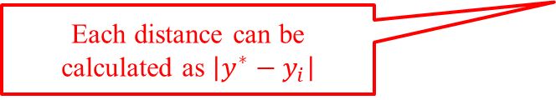
Least Squares Method
Least square solution:
Draw vertical lines from each value to the imagined true length, so the distance between each value to the true length is the error for each value.
Distance is the error of y₁ against the true length y*
y*
Each distance can be calculated as $\left|y^{∗}−y_{i}\right|$
x1
x2
x3
x4
x5

Slide 24

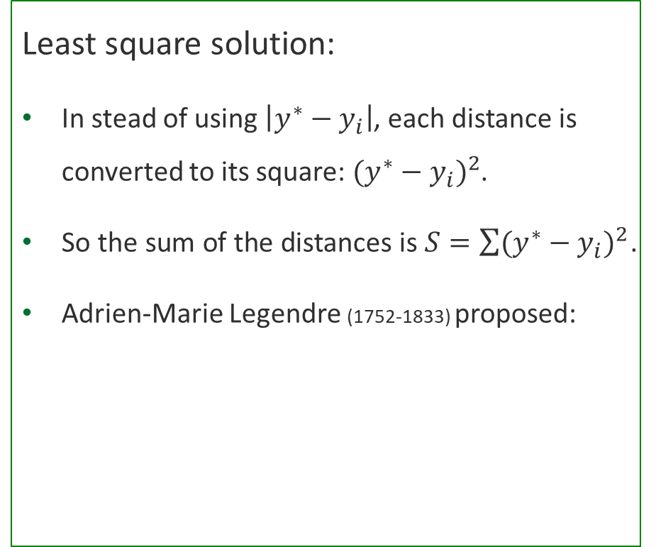
Least Squares Method
Least square solution:
In stead of using $\left|y^{∗}−y_{i}\right|$, each distance is converted to its square: ${(y^{∗}−y_{i})}^{2}$.
So the sum of the distances is $S=\sum{{(y^{∗}−y_{i})}^{2}}$.
Adrien-Marie Legendre (1752-1833) proposed:
y*
x1
x2
x3
x4
x5
If we can find a y* to minimize the sum of the errors, then y* is the true value!
min $\sum{{(y^{∗}−y_{i})}^{2}}$ true y*
Find the minimum sum of distances for the true y*.

Slide 25
Least Squares Method
Least squares method equation:
min $\sum{{(y^{∗}−y_{i})}^{2}}$
y$i$ = observed value of the dependent variable for the ith
observation
$y^{∗}$= predicted value of the dependent variable for the $i$th
observation

Slide 26
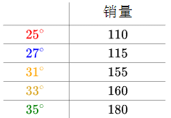
Least Squares Method
Another Least Square application:
The relationship between weather temperature and ice cream sales can be shown as:
Temperature
Sales
In different temperature, the sales of ice cream varies

Slide 27
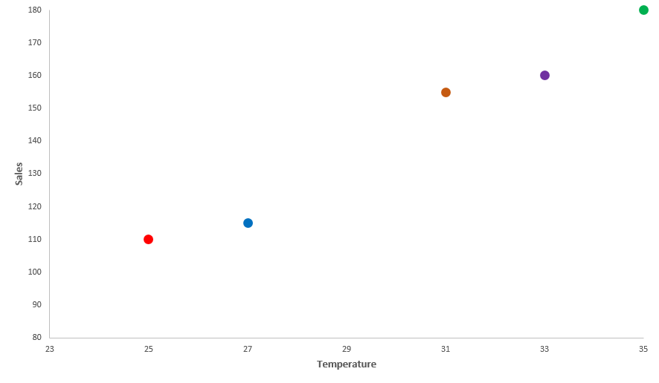
Least Squares Method
Another Least Square application:
Plot the data in a matrix and imagine a lineal line with the same trend as the values.
f(x)
Imagine a lineal line represented as f(x), and f(x)=ax+b

Slide 28
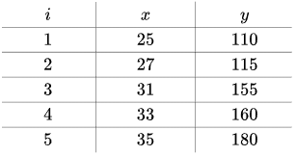
Least Squares Method
Another Least Square application:
Using the Least Square solution, draw vertical lines from each dot to the f(x) line.
In the figure, i, x and y:
f(x)
f(x4)
f(x5)
f(x3)
f(x2)
Draw distances from yi to f(xi)
f(x1)

Slide 29
Least Squares Method
Another Least Square application:
So $S=\sum{{(f(x_{i})−y_{i})}^{2}=\sum{{(ax_{i}+b−y_{i})}^{2}}}$.
By solving multivariate calculus to obtain the minimized S.
a≈7.2
b≈-73
“How to solve” is not part of this course’s content
f(x)
Putting a≈7.2 and b≈-73 in the imagined f(x), the green line is generated, which is the lineal regression of the dots.

Slide 30
Least Squares Method
Another Least Square application:
We can also imagine the f(x) as a non-lineal line.
Say $f\left(x\right)=ax^{2}+bx+c$, after using least square method to obtain a, b and c, we get:
f(x)
The more complicated f(x) we imagine, the higher the degree of fitting between the line and the dots.

Slide 31
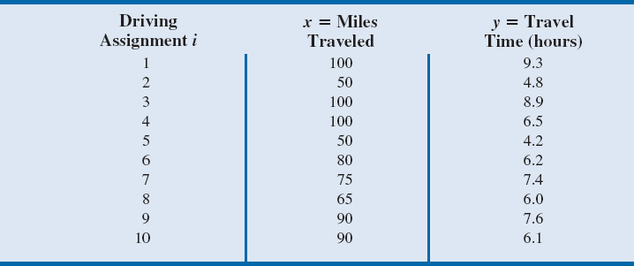
Table 4.1 - Miles Travelled and Travel Time (in Hours) for Ten Butler Trucking Company Driving Assignments
Notes:
To illustrate the Least Squares method, suppose data was collected from a sample of ten Butler Trucking Company driving assignments.
For the ith observation or driving assignment in the sample, x_{i} is the miles travelled and y_{i} is the travel time (in hours).
The values of x_{i} and y_{i} for the ten driving assignments in the sample are summarised in Table 4.1.

Slide 32
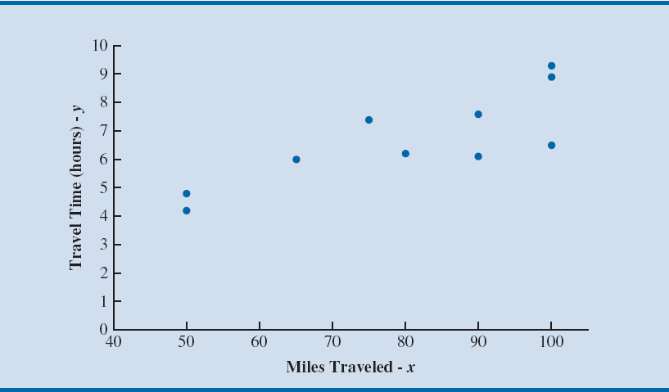
Figure 4.3 - Scatter Chart of Miles Travelled and Travel Time in Hours for Sample of Ten Butler Trucking Company Driving Assignments
Notes:
Figure 4.3 is a scatter chart of the data in Table 4.1.
Miles travelled are shown on the horizontal axis, and travel time (in hours) is shown on the vertical axis.
Longer travel times appear to coincide with more miles travelled.
The relationship between the travel time and miles travelled appears to be approximated by a straight line; indeed, a positive linear relationship is indicated between x and y.
Therefore, the simple linear regression model is chosen to represent this relationship.

Slide 33
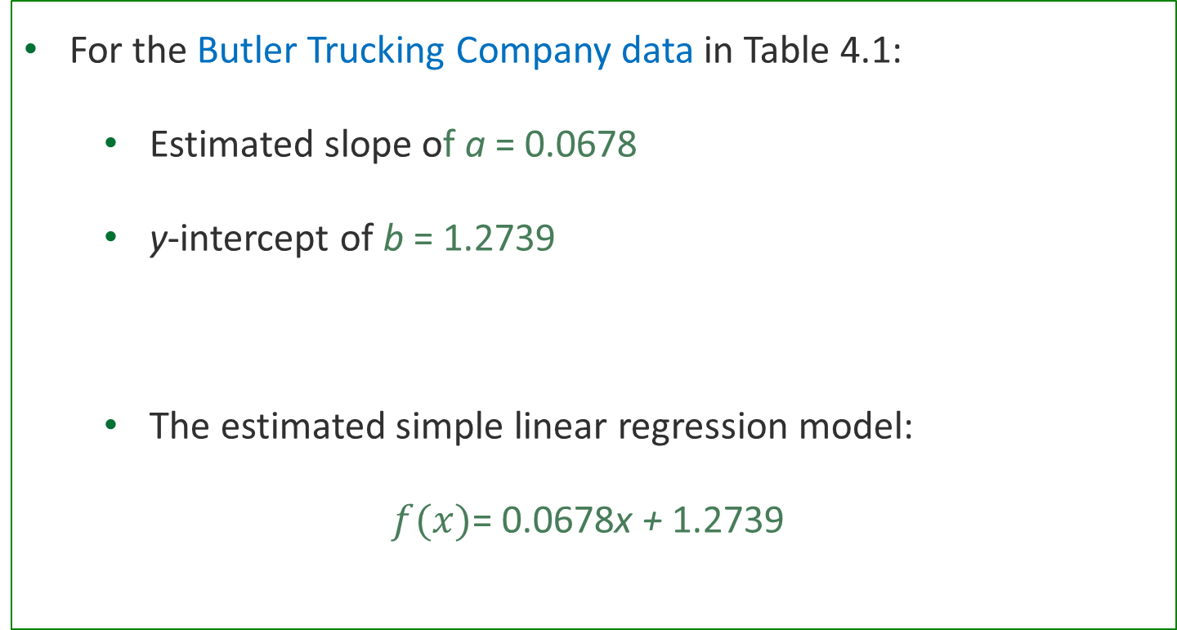
Least Squares Method
For the Butler Trucking Company data in Table 4.1:
Estimated slope of a = 0.0678
y-intercept of b = 1.2739
The estimated simple linear regression model:
$f(x)$= 0.0678x + 1.2739
Notes:
We interpret b and a as we would the y-intercept and slope of any straight line.

Slide 34
Least Squares Method
Butler Trucking Company example:
Use the estimated model and the known values for miles traveled for a driving assignment (x) to estimate mean travel time in hours.
The estimated simple linear regression model:
$f(x)$= 0.0678x + 1.2739

Slide 35
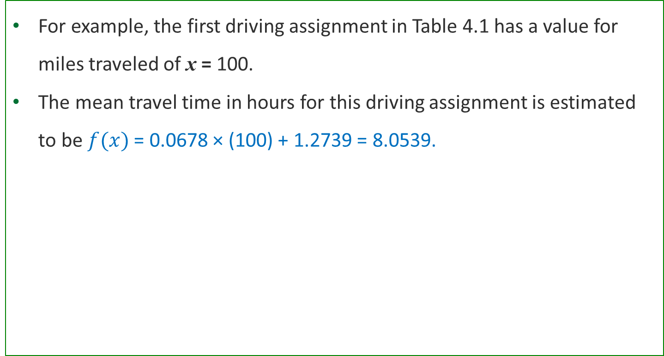
Least Squares Method
For example, the first driving assignment in Table 4.1 has a value for miles traveled of x = 100.
The mean travel time in hours for this driving assignment is estimated to be $f(x)$ = 0.0678 × (100) + 1.2739 = 8.0539.
0.0678 × x + 1.2739
=
0.0678
×
100
+
1.2739
=
8.0539

Slide 36
Figure 4.3 - Scatter Chart of Miles Travelled and Travel Time in Hours for Sample of Ten Butler Trucking Company Driving Assignments
$f(x)$= 0.0678x + 1.2739
Regression Line
Notes:
Figure 4.3 is a scatter chart of the data in Table 4.2.
Miles travelled is shown on the horizontal axis, and travel time (in hours) is shown on the vertical axis.
Longer travel times appear to coincide with more miles travelled.
The relationship between the travel time and miles travelled appears to be approximated by a straight line; indeed, a positive linear relationship is indicated between x and y.
Therefore, the simple linear regression model is chosen to represent this relationship.

Slide 37
Least Squares Method
Interpretation of a - If the length of a driving assignment was 1 unit (1 mile) longer, the mean travel time for that driving assignment would be 0.0678 units (0.0678 hours, or approximately 4 minutes) longer.
Interpretation of b - If the driving distance for a driving assignment was 0 units (0 miles), the mean travel time would be 1.2739 units (1.2739 hours, or approximately 76 minutes).

Slide 38
Least Squares Method
Experimental region: The range of values of the independent variables in the data used to estimate the model.
The regression model is valid only over this region.
Extrapolation: Prediction of the value of the dependent variable outside the experimental region is risky.
Notes:
Because we have no empirical evidence that the relationship we have found holds true for values of x outside of the range of values of x in the data used to estimate the relationship, extrapolation is risky and should be avoided.
For Butler Trucking, this means that any prediction outside the travel time for a driving distance less than 50 miles or greater than 100 miles is not a reliable estimate and so for this model, the estimate of a is meaningless.
However, if the experimental region for a regression problem includes zero, the y-intercept will have a meaningful interpretation.

